Slide 1
Band type EMG device for athletes injury prevention
CINe Lab. Dongju Kim 20230607

Slide 2
Injuries in sports
There are many types of injuries in sports, such as fractures, sprain, and muscle injuries.
Among them, fractures and sprains are often caused by accidents, but muscle injuries often occur without special collisions.
Muscle injuries usually start with increased muscle fatigue.
If coach or manager can predict these cases through muscle fatigue and prevent injuries, players will be able to continue their life as an athlete better.
Furthermore, in the case of team sports, they will be able to achieve team's plan better.

Slide 3
Example of the relationship between EMG signals and muscle fatigue
Normal muscle
muscle with high muscle fatigue
This is raw EMG when arm muscles are tightened in normal condition, and the figure below is raw EMG signal when muscle contraction is high in muscle fatigue.
Looking at this in the power spectrum space, the overall power spectrum distribution shifts toward the low-frequency component when the muscle fatigue increases as follows.
That is, the EMG signal varies according to muscle fatigue. That's the point.

Slide 4
Abstract
Band with muscle fatigue measurement technology using EMG signal measurement technology
Wear a band on the main injury area of the athletes,
For example, a soccer player with frequent right hamstring injuries wears a band on his right hamstring, in the case of pitchers, shoulder injuries are frequent, so a band is worn on the shoulder.
Through this, expressing the possibility of injury by calculating muscle fatigue
View the potential for injury expressed and provide the possibility of player condition management through injury prevention and a change of player
Based on EMG signal data just before the injury collected, the accuracy of the injury prediction can be increased

Slide 5
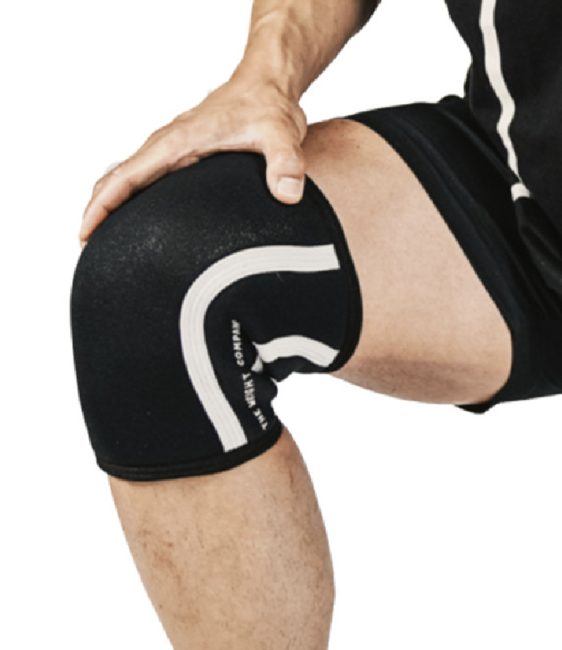
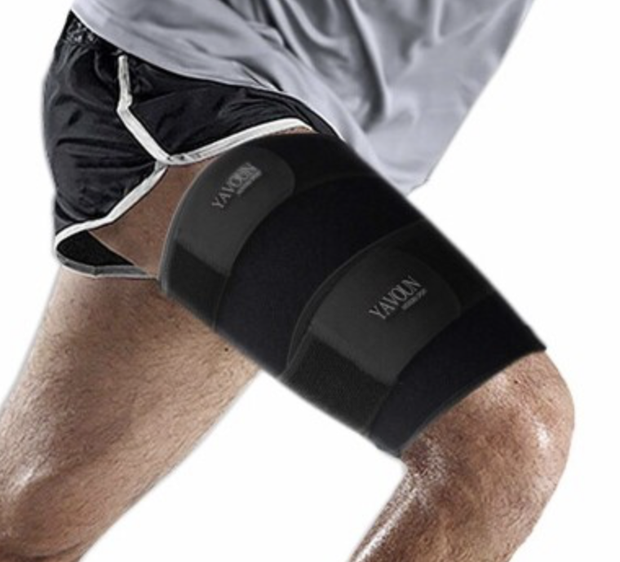
Representative drawings and brief description of drawings
Band type device using EMG sensor
Use the BLE protocol module to show information to the supervisor and coach, or on your phone
The battery uses rechargeable or small coin cell batteries

Slide 6
Ref
“Causes of thigh muscle injury”, 대한정형외과학회,2023 06 07, https://www.koa.or.kr/info/index_7_9.php

